Slide 1
A/C System Pressure Diagnostics
Low Side High Side
  Low Low
  High High
  Normal High
  Low High
  High Low
  Low Normal
Problem

Slide 2
A/C System Pressure Diagnostics
Low Side High Side
Problem
  Low Low
Low Charge
  Too much Charge, air in system, too much oil
  High High
  Condenser plugged, insufficient cooling
Normal High
  Low High
  Restriction, receiver/dryer or expansion valve
  High Low
Compressor BAD
  Low Normal
  Evaporator plugged

Slide 3
Sensible heat makes sense. It can be felt and measured on a thermometer. If we have 1 lb of water at 40*F and put 1 btu of heat to it, the temperature will increase to 41*F. and another will raise it to 42* F. and this will continue until the boiling point is reached. Once 212*F is reached the water will start to boil, but the water and steam temperature will remain at 212*F. The added heat has caused some of the water to change state, but it has not changed temperature. This is an example of latent or hidden heat. After it changes to steam it takes more BTU’s to raise the temperature of steam than water.
212 F
Boiling Latent Heat of Evaporation
Cooling Latent Heat of Condensation
32 F
0 F
Ice
Heat Added
Steam
Notes:
Sensible heat makes sense. It can be felt and measured on a thermometer. If we have 1 lb of water at 40*F and put 1 btu of heat to it, the temperature will increase to 41*F. and another will raise it to 42* F. and this will continue until the boiling point is reached. Once 212*F is reached the water will start to boil, but the water and steam temperature will remain at 212*F. The added heat has caused some of the water to change state, but it has not changed temperature. This is an example of latent or hidden heat. After it changes to steam it takes more BTU’s to raise the temperature of steam than water.

Slide 4
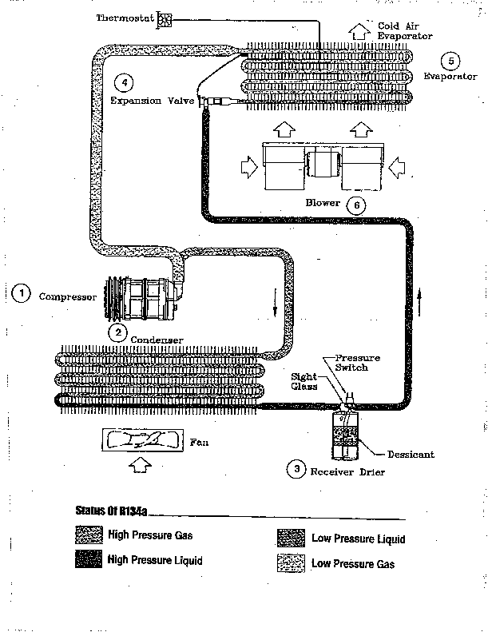

Slide 5
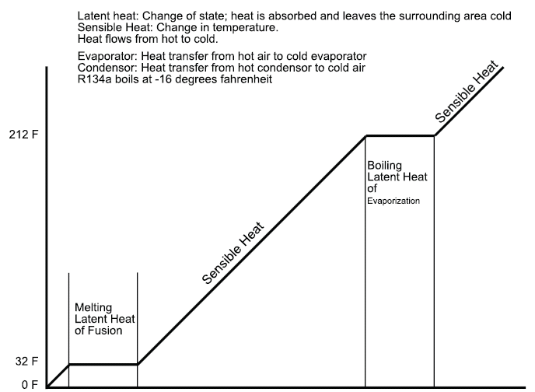
Ice
Heat Added
Steam
Notes:
Sensible heat makes sense. It can be felt and measured on a thermometer. If we have 1 lb of water at 40*F and put 1 btu of heat to it, the temperature will increase to 41*F. and another will raise it to 42* F. and this will continue until the boiling point is reached. Once 212*F is reached the water will start to boil, but the water and steam temperature will remain at 212*F. The added heat has caused some of the water to change state, but it has not changed temperature. This is an example of latent or hidden heat. After it changes to steam it takes more BTU’s to raise the temperature of steam then water.

